Slide 1
Group 1 Project 1
Vehicle Sales Data

Slide 2
Participants
Project-1-part-1-Abdifatah
Project-1-part-2-Vitorio
Project-1-part-3-Priti
Project-1-part-4-Edward
Project-1-part-5-Mohamed
Project-1-part-6-Sheyma
Project-1-part-7-Najma

Slide 3
Segments
The five brands that are the most popular
The five least brands that sold.
The most popular transmission sold
What state has the most cars according to this data
The body type that sold the most - top 5 and the bottom 5 - if we have why then why -
Selling price - the most expensive/least expensive
What colour is most popular to buy
Which year were the most cars sold
Which seller sold the most cars and which sold the least
The number of sales over time (e.g., monthly or yearly)
Notes:
he number of sales over time (e.g., monthly or yearly)

Slide 4
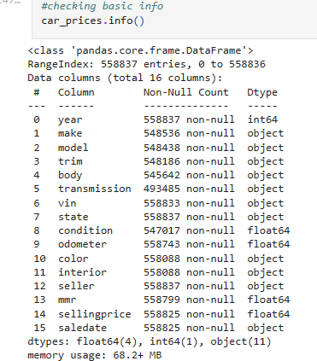
Analysing a car sales dataframe
A data frame composed of 558.837 rows and 16 columns.
A number of different types of data are present, including:
Integers, floats and objects.

Slide 5

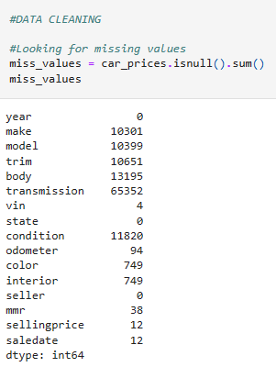
01
Data cleaning
We begin by scanning the data frame, looking for mistakes and /or missing informations.
The window to the right displays the amount of blank value for each column, suggesting the data might have been corrupted at some point whilst inputting.
HOME

Slide 6
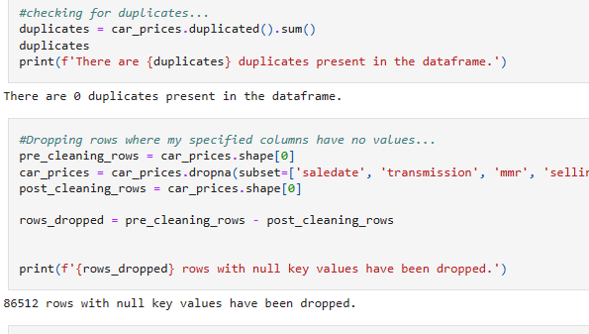
Duplicates & corrupted data
Fortunately no duplicates were found in the database, however we managed to drop 86.512 rows with corrupted data.
Notes:
Project-1-part-1-AbdifatahProject-1-part-2-VitorioProject-1-part-3-PritiProject-1-part-4-EdwardProject-1-part-5-MohamedProject-1-part-6-SheymaProject-1-part-7-Najma

Slide 7
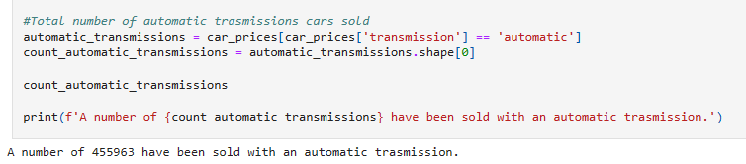
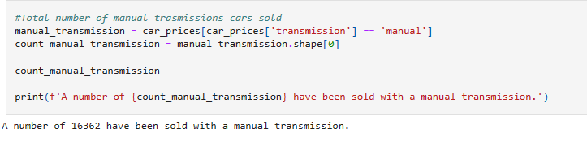
Automatic vs manual transmission
sales
We start analysing our first subjects, such as the demand for automatic cars vs manual.
We found that 455.963 automatic cars were sold between 1990 between 1990 and 2015.
While only 16.362 manual cars were sold during this period of time.

Slide 8
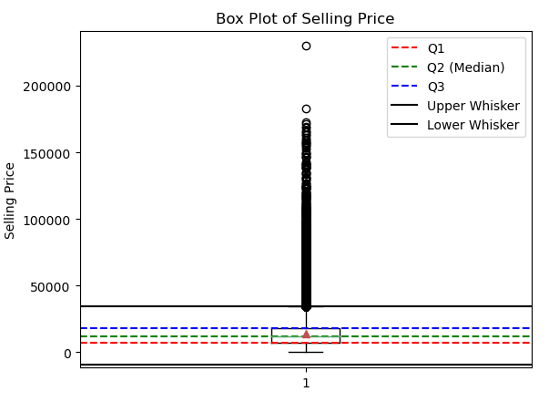
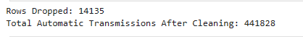
Automatic cars, BoxPLOT
This boxplot is showing a number of outliers, which we will cut out from out analysis.
We manage to drop 14.135 rows with potential incorrect data.

Slide 9
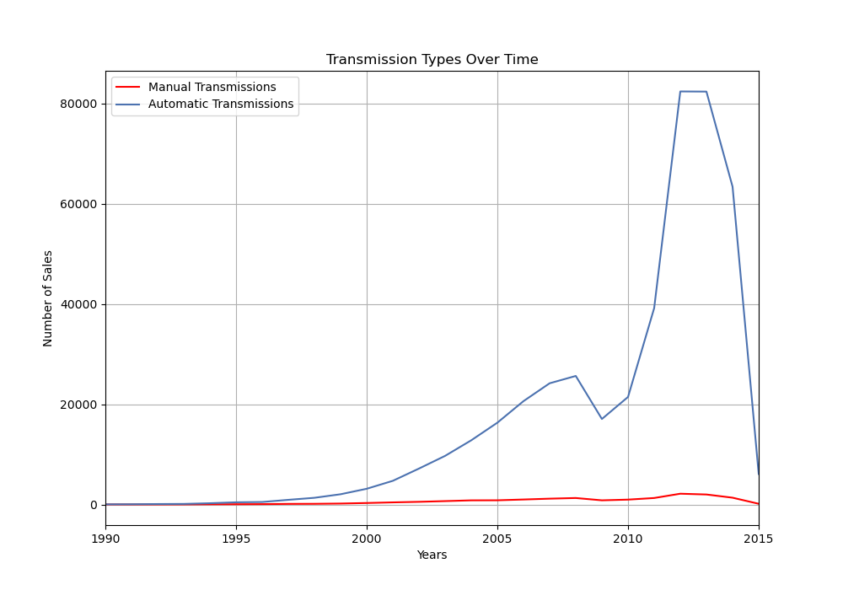


Number of sales per type of transmission
Automatic transmission
Manual transmission
TEXT

Slide 10
A snippet of code
Edward
car_sales_df = (car_sales_1, body_type_1, columns = ['Car Sales])
car_sales_df.plot (kind = 'bar',
title = 'Car Sales vs Body Type',
figsize = (15, 6))
plt.savefig ('car_sales.png', dpi = 400)
plt.show ()
This was used to create, save and show a bar chart

Slide 11
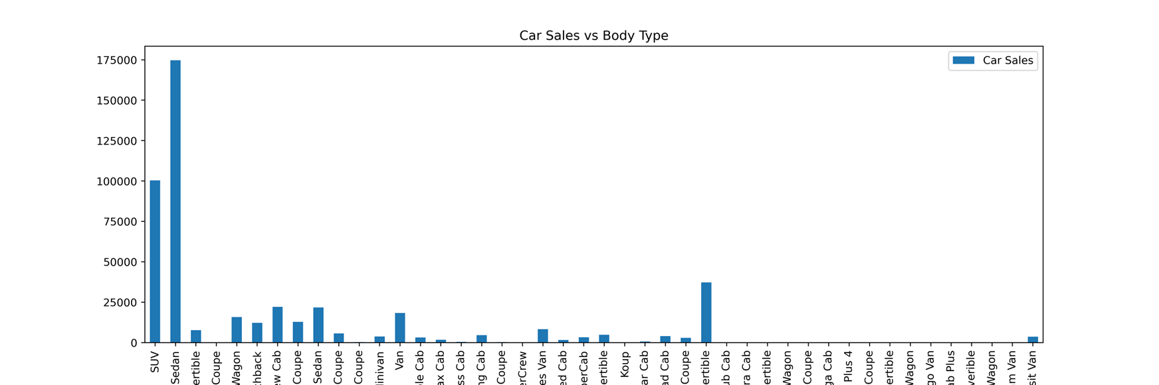
Bar chart of car sales vs body type
Edward

Slide 12

Findings
Edward
Out of about half-a-million cars the Sedan body type sold the most (about 175 000 sales), followed by the SUV and the G37 Convertible.

Slide 13
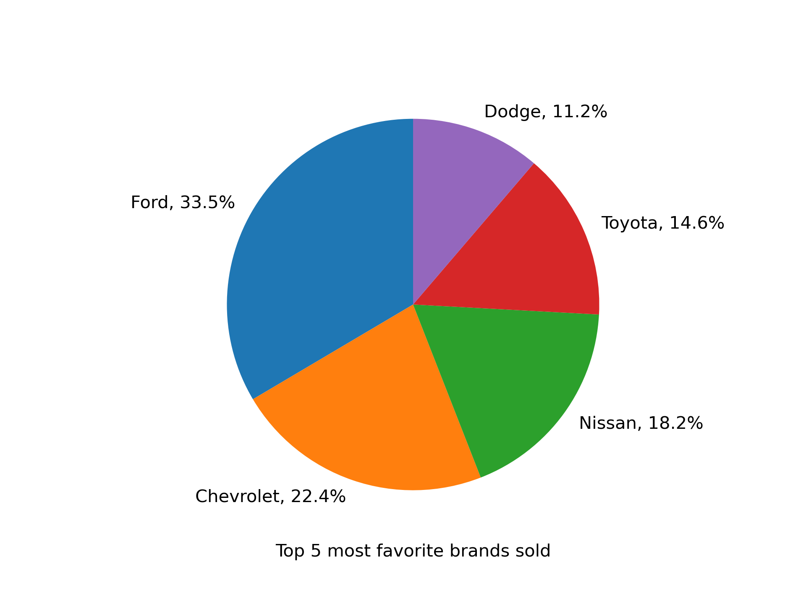
Abdifatah
Market Majesty to Market Mystery: The Tale of Brand Sales
Did you know that the top-selling brand in our analysis outperforms the bottom brands by 99.97% in sales?
Ford Dominates: Ford leads the market among the top 5 most sold brands, claiming a significant share of 33.5%, outpacing its closest competitor by over 10%. Chevrolet and Nissan Follow:

Slide 14
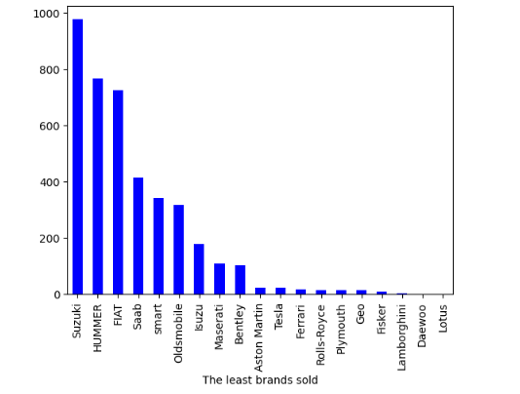
"Unveiling the Undercurrents: A Glimpse into Niche Markets"
Abdifatah
Suzuki Leads the Pack
Exclusive Brands Remain Niche: High-end manufacturers such as Aston Martin, Ferrari, and Lamborghini report low sales volumes

Slide 15
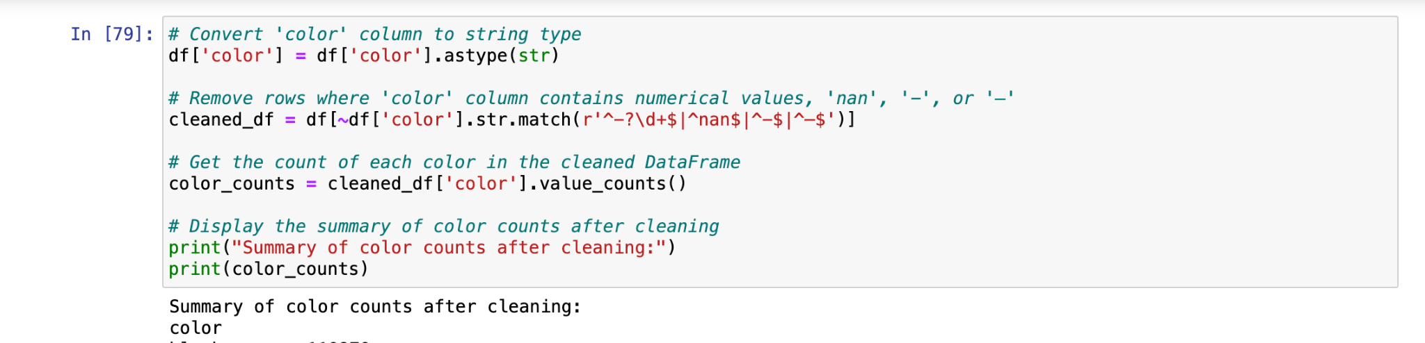
Colour analysis
Sheyma
Initially, our dataset revealed a troubling reality: a myriad of rows plagued by missing or incomplete data. The first step was to remove these missing rows in order to get the most accurate data.
The screenshot below illustrates how we were able to remove the blank data and get a more accurate analysis.
Once completed, Jupyter Notebook displayed the rows alongside the amount sold of each colour. At present, this was not done in order.

Slide 16
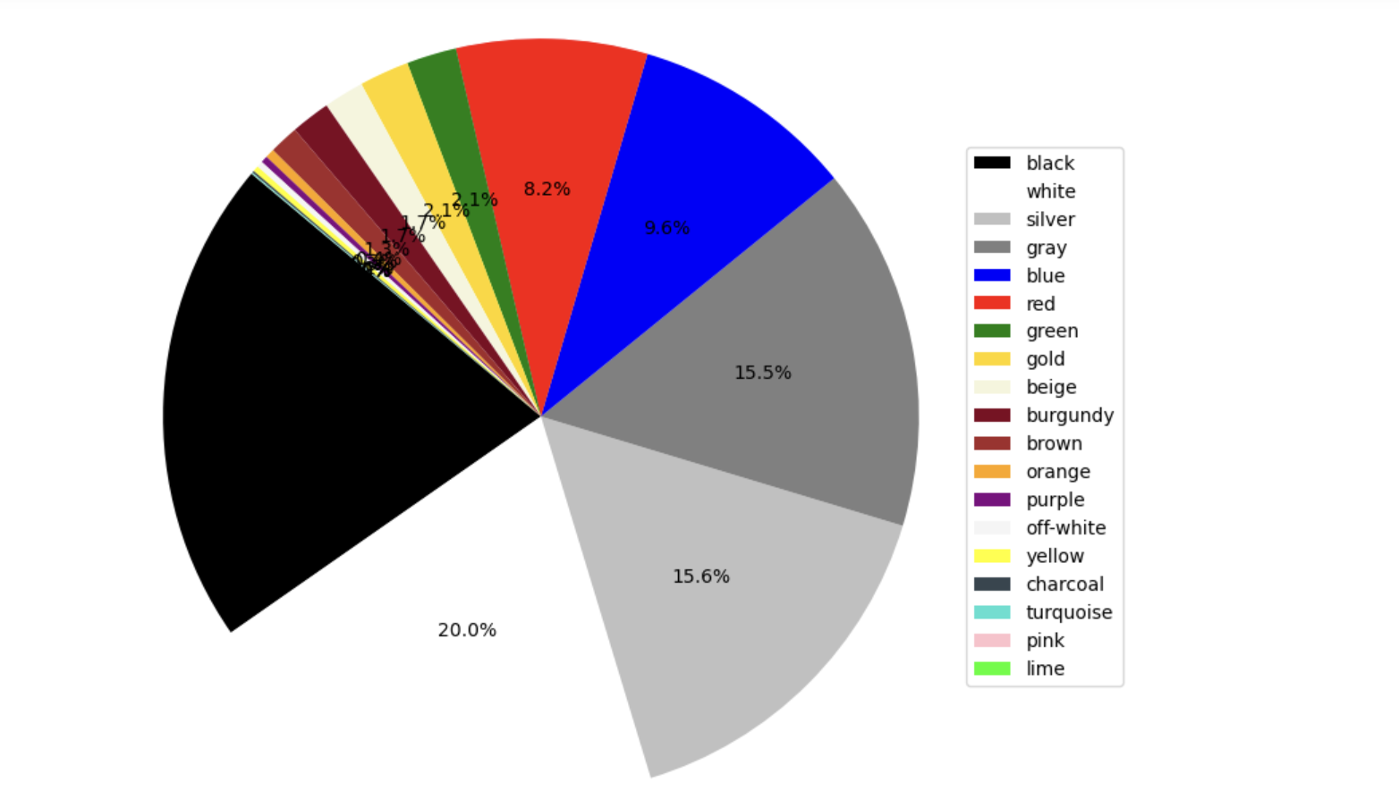
VISUALISING Colour analysis
Sheyma
After completing the data cleaning process, our next step was to visually analyse the data using Matplotlib. Initially, we attempted to represent the data with a pie chart. However, given the substantial volume of data, the resulting visualisation appeared cluttered and lacked clarity, as shown below.

Slide 17
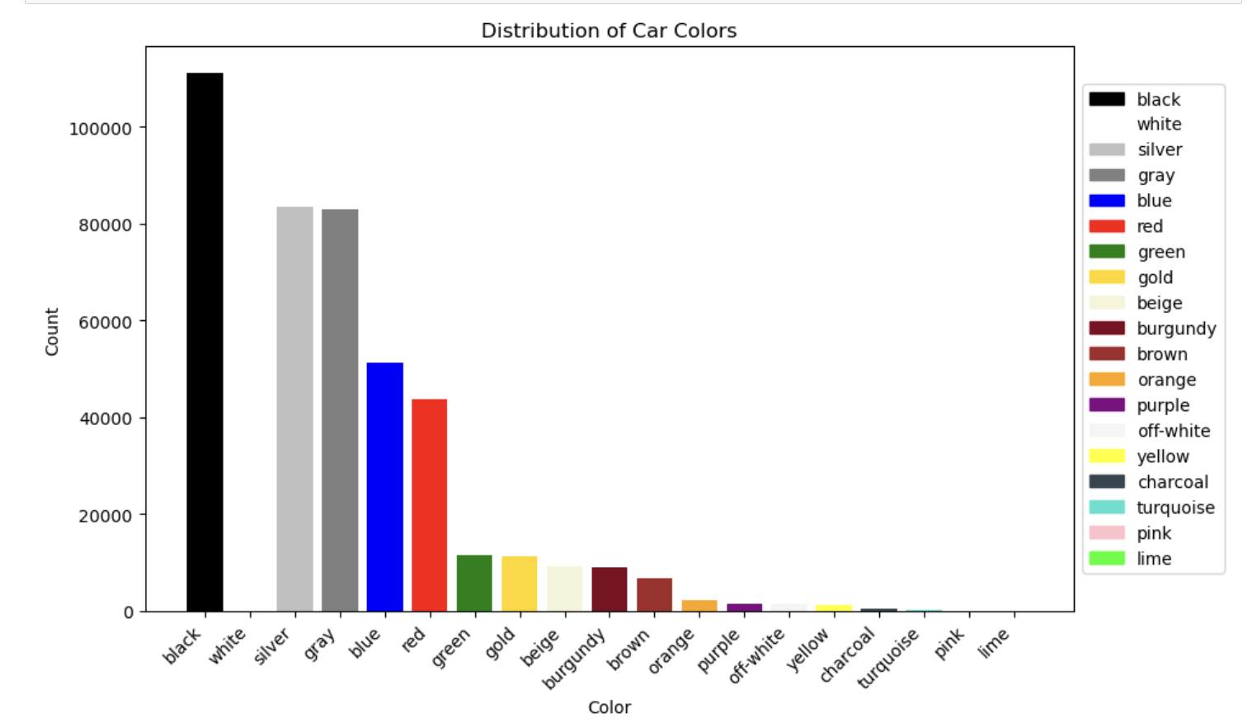
VISUALISING Colour analysis
Sheyma
Within the same code, we also experimented with presenting the data as a bar graph. This approach proved to be more effective, as it allowed us to distinctly visualise the hierarchy of colors from most sold to least sold. Additionally, we enhanced the clarity of the visualisation by incorporating color-coding that corresponds to each respective car color.

Slide 18
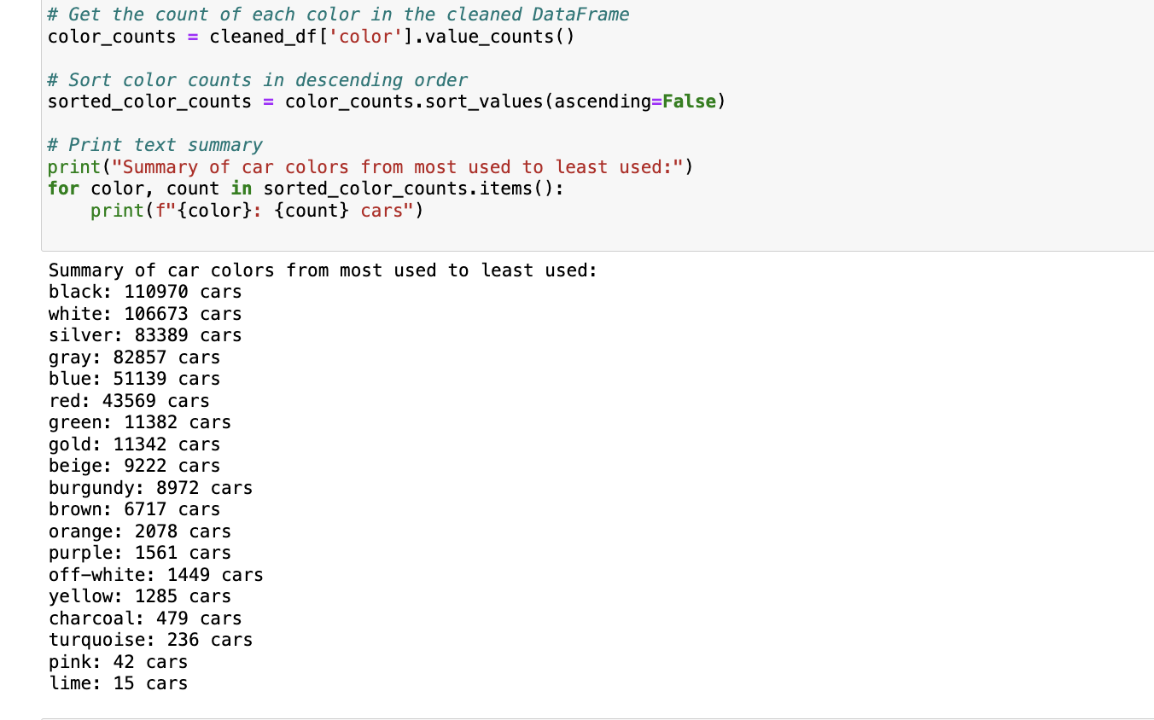

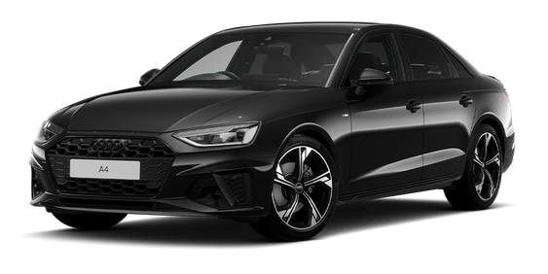
VISUALISING Colour analysis
Sheyma
Lastly, to ensure clarity, we opted to include the data in written form alongside the visual representations.
Through this code, we successfully condensed and outlined the color sales from highest to lowest, and the most sold colour was…
BLACK!

Slide 19
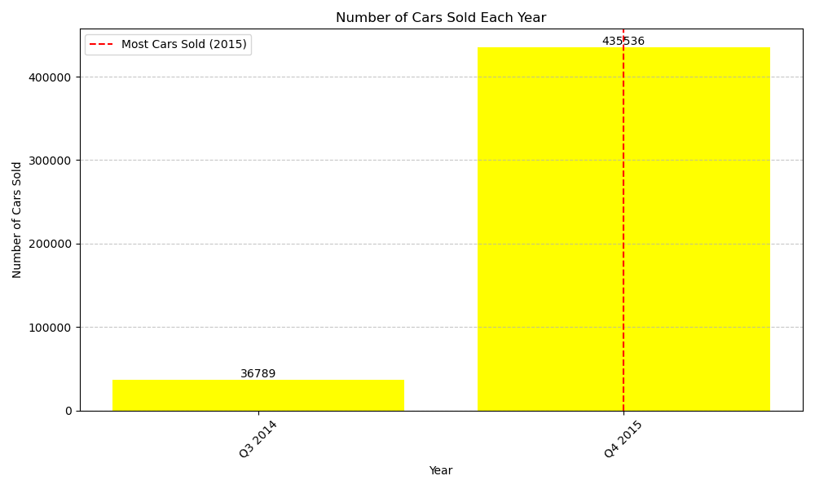
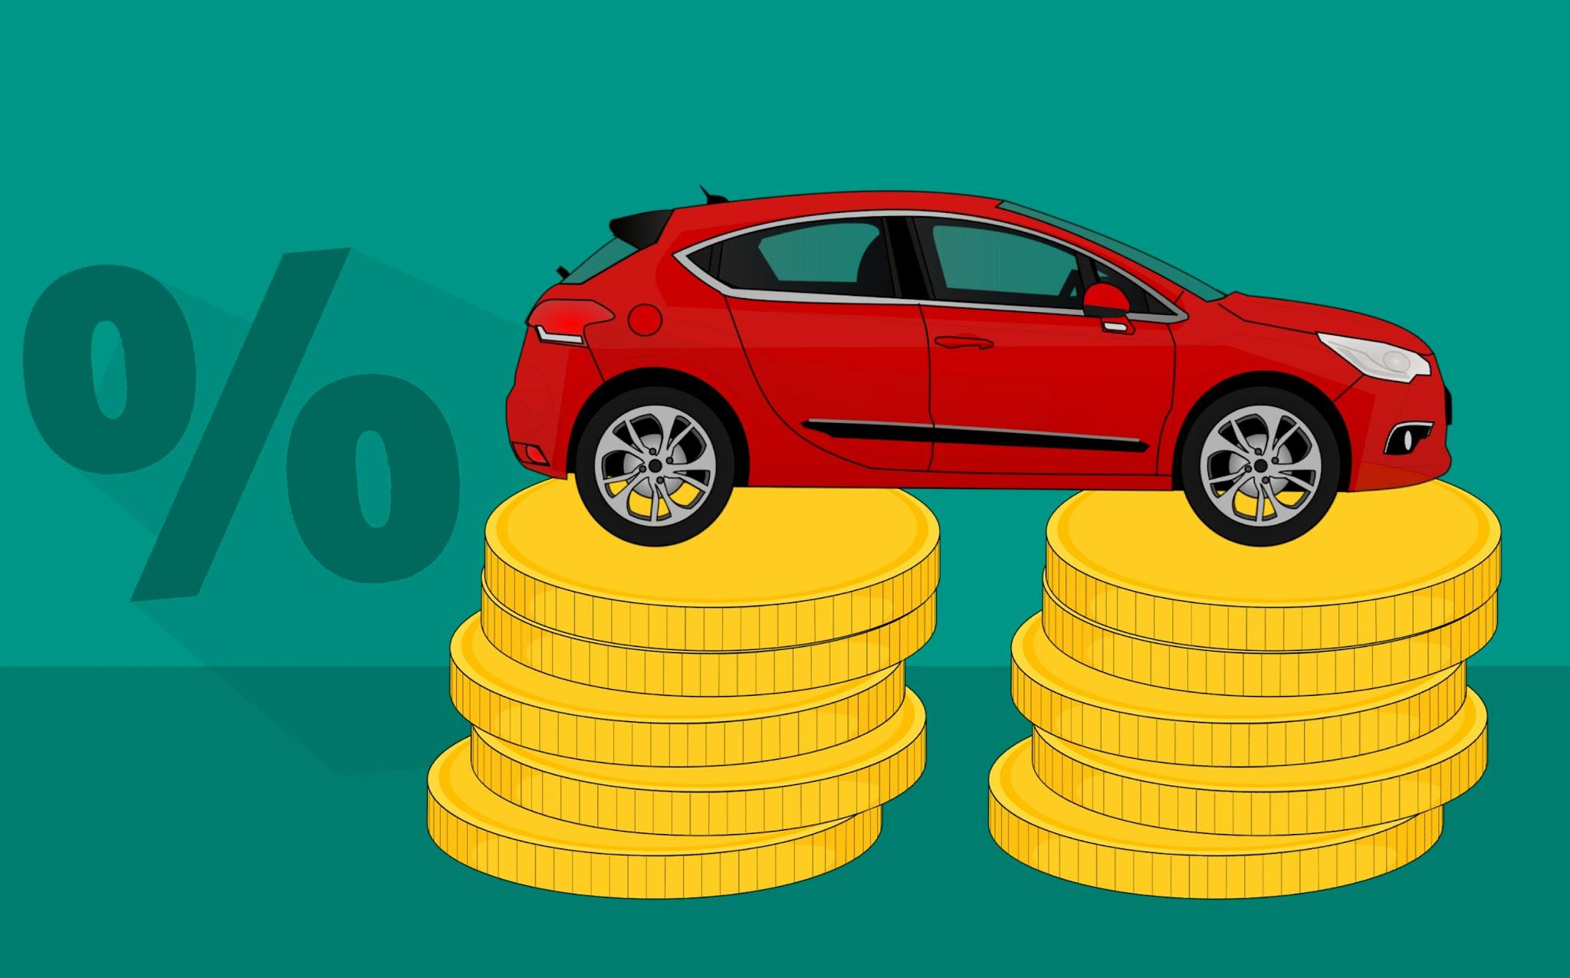
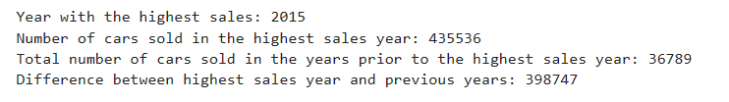
Yearly Comparison: Peak Sales in 2015:
Sales soared from 36,789 in Q3 2014 to a peak of 435,536 in Q4 2015.
The sales peak in Q4 2015 highlights the importance of market demand and business performance analysis.
Understanding peak trends is critical for tailoring effective market strategies.
Leveraging data insights is key to operational optimization and sustainable sector growth.
The 2015 sales data underpin the value of data-driven decision-making for future success.

Slide 20
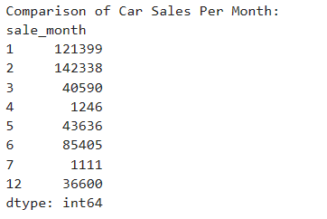

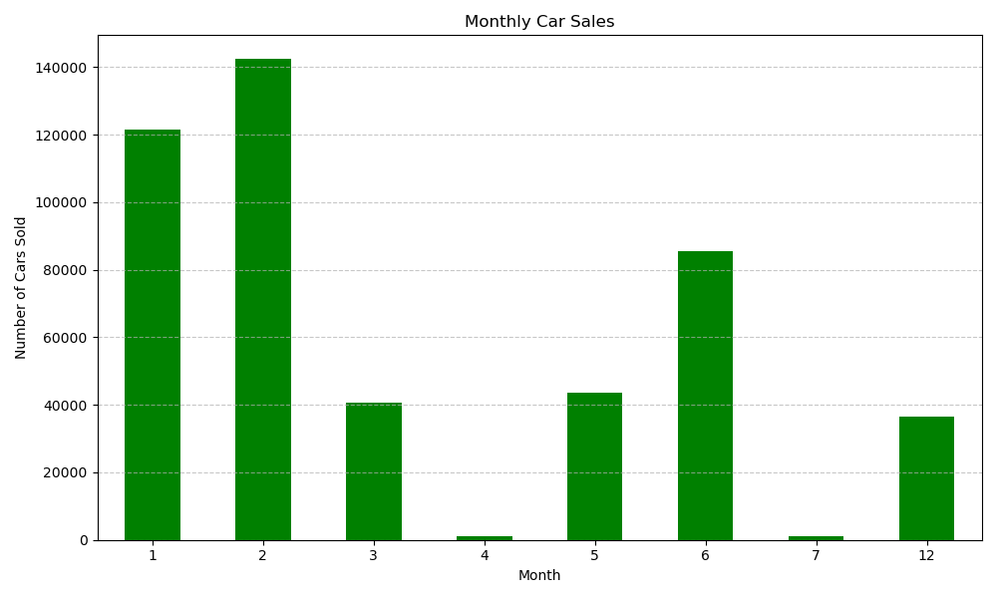
Temporal Sales Patterns:
Seasonal Patterns in Car Sales:
January and February have relatively higher sales numbers compared to other months, indicating potential seasonal patterns or factors influencing consumer behavior during those periods.
Months like April, July, and December have notably lower sales figures compared to other months.
The data provides insights into the monthly variations in car sales volume, which can be valuable for businesses in understanding market dynamics and planning their operations accordingly.

Slide 21
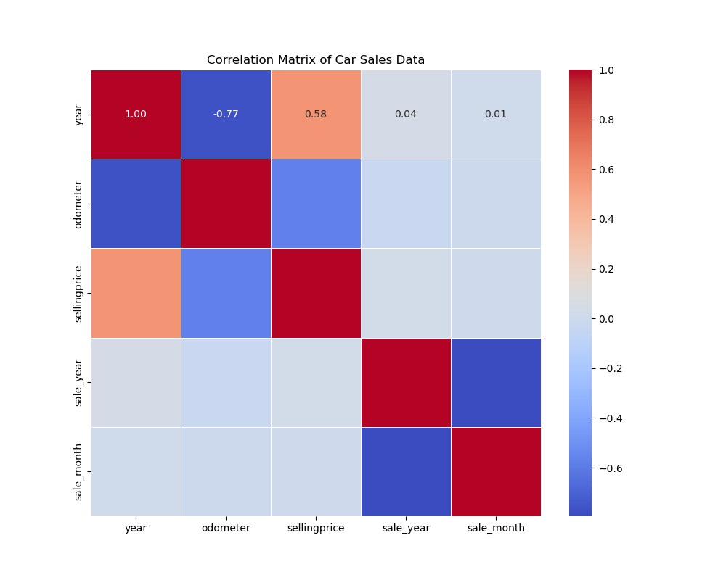
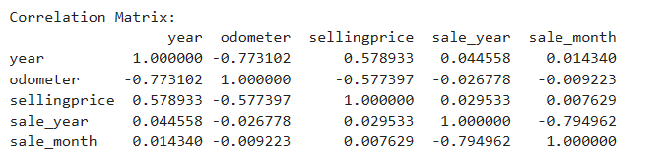
Correlation Analysis of Car Sales Data:
Year correlates positively with selling price (0.5789) and negatively with odometer (-0.7731).
Odometer negatively correlates with both year (-0.7731) and selling price (-0.5774).
Selling price positively correlates with year (0.5789) and negatively with odometer (-0.5774).
Sale year and month exhibit a strong negative correlation (-0.7949), indicating earlier sales in the year.

Slide 22
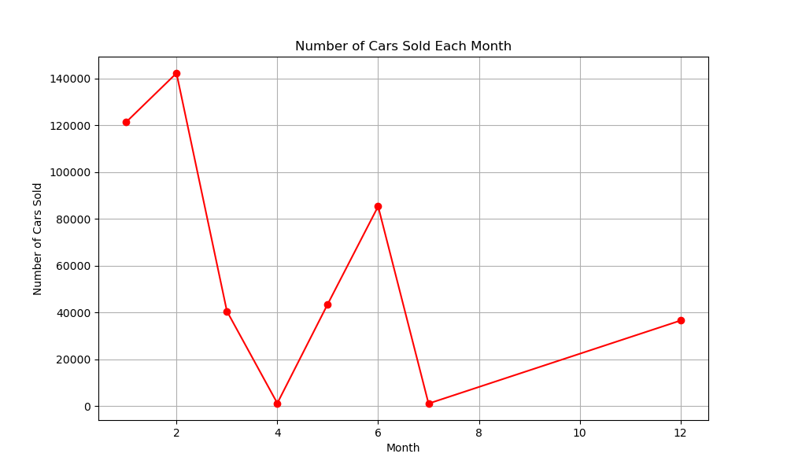
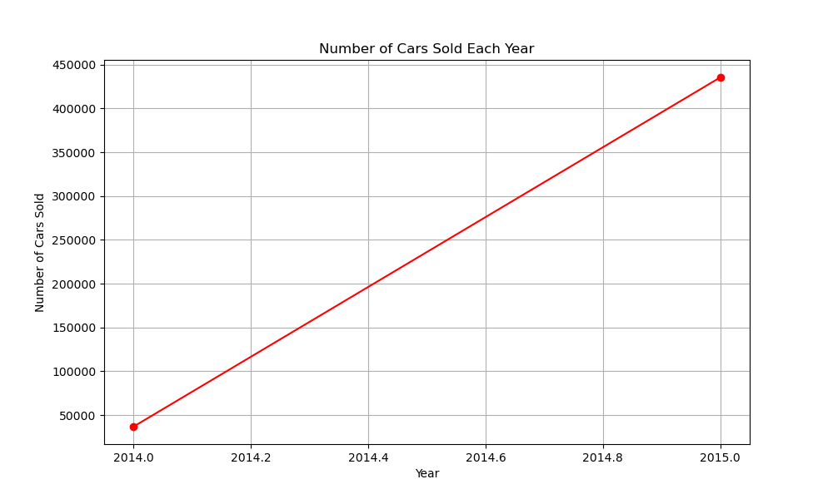
The plot illustrates the total number of car sales recorded for each year.
A clear trend of increasing sales can be observed from 2014 to 2015, followed by a slight decline in subsequent years.
This visualization provides insights into the overall trend of car sales over time, aiding in understanding market dynamics and identifying potential areas for further analysis or intervention.
This plot displays the total number of car sales recorded for each month across all years.
There are variations in sales volume across different months, indicating potential seasonal trends or fluctuations.
Analyzing monthly sales data allows for a more granular understanding of sales patterns throughout the year, which can inform marketing strategies, inventory management, and other business decisions.
Najma

Slide 23

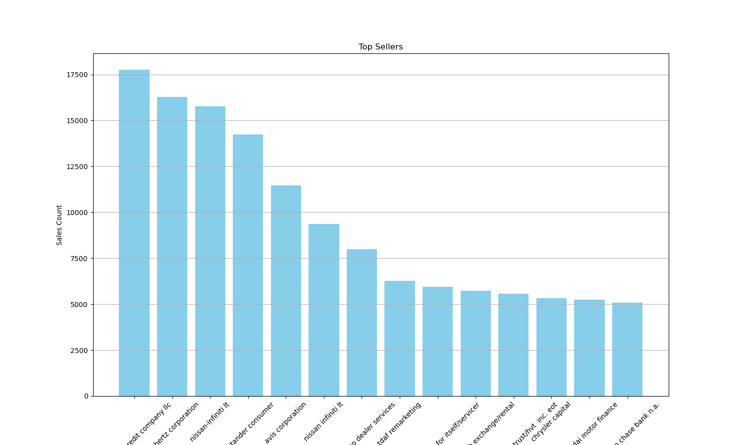
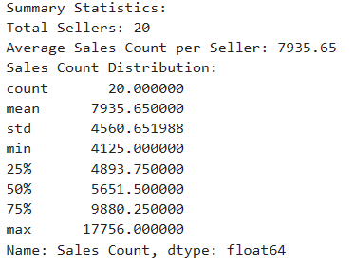
Seller Performance Comparison:
This comparison highlights the range in sales performance among different sellers in the dataset.

Slide 24
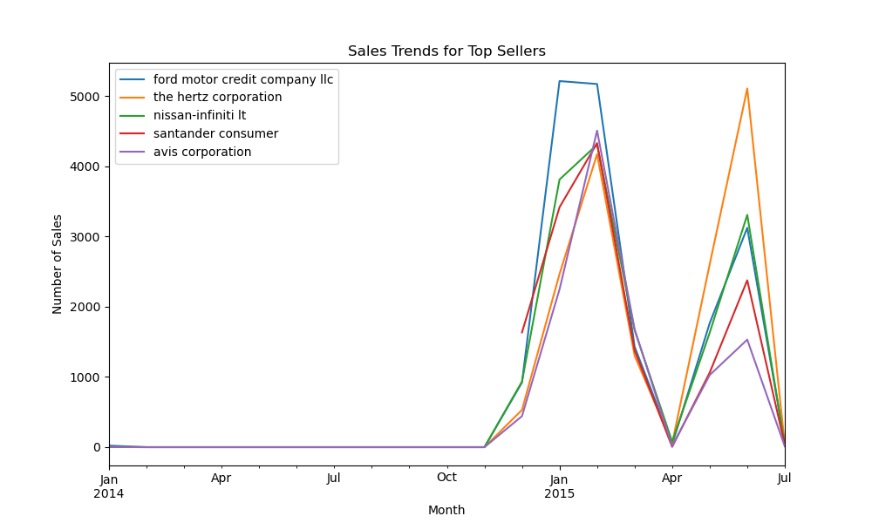
Sales Trends for Top Sellers:
The graph shows sales trends for top sellers over 18 months.
Noticeable peaks in April and October could indicate seasonal sales cycles or effective marketing campaigns.
All sellers experience similar fluctuations, suggesting market-wide influences.
Understanding these patterns can inform the timing and focus of sales strategies.

Slide 25
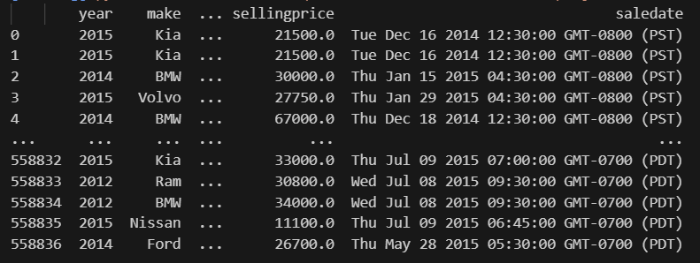
The most expensive/least expensive
Most Expensive car : Ford Escape ( $230000.0 )
Least Expensive car : Ford F-350 Super Duty ( $7000.0 (
Mohammad

